Slide 1
Hybrid machine learning and optimization approach for modeling Black-box functions

Slide 2
Introduction
Black-box optimization problems arise in areas such as logistics, engineering design, energy generation, etc.
These problems are in general computationally expensive and NP-hard and hence difficult to solve for global optima.
Various algorithmic implementations exist whose success rate of finding global optima depend on convexity and smoothness of the function

Slide 3
Problem Definition
Carry out Derivative-Free Optimization (DFO) of the problem library
Achieve the best solution while limiting the maximum number of function evaluations to 2500.
Obtain an algorithm to optimize black-box models with high degrees of freedom.

Slide 4
Sampling Methods
Selection of sampling points has an immense impact on the fitness of the surrogate model
The quasirandom numbers have an advantage over pure random numbers can cover the domain of interest quickly and evenly.
Thus, the usage of quasi-random low-discrepancy sequences improves the convergence of the model
Sampling techniques used:
SOBOL sampling
Latin hypercube
Hammersley

Slide 5
Literature Survey
The algorithm for this work draws inspiration from the paper on Parallel Boosting with Momentum (https://doi.org/10.1007/978-3-642-40994-3_2).
In this algorithm, only first moment is used
Reaching (1) by minimizing the surrogate model and reduce the search domain
If an iteration gives worse value (2), the point stays at the same location (3) until the patience limit is reached
This greedy search is necessary since the Nesterov’s momentum term can drive the solution away from the optimum (local or global)
Instead greater number of samples are collected in a larger domain for getting improved model fit
1
2
3

Slide 6
Block diagram of the Algorithm
Until Termination Criteria
Select a Starting point X^{SP}
For ‘N’ epochs
Applying block coordinate descent on X*
To improve modeling by ALAMO, after each epoch, the variables in a block are grouped based on variables with similar steepness
Add Nesterov’s momentum to X* and do sampling
Fit model using ALAMO and find the best point
NO
Update parameters and move to next block
Resample additional points
New point X^{opt} better than X*
Patience factor terminated
NO
YES
YES
Set X* = X^{opt}
Record local optima and move to next X^{SP}

Slide 7
Hyperparameters for the algorithm
Number of sampling points (N^{SP})
Scaling factor (sf)
Number of attributes in a block (n)
Patience factor
Sampling technique
Type of model (e.g. linear, polynomial, etc.)
Maximum epochs
Tolerance limit

Slide 8
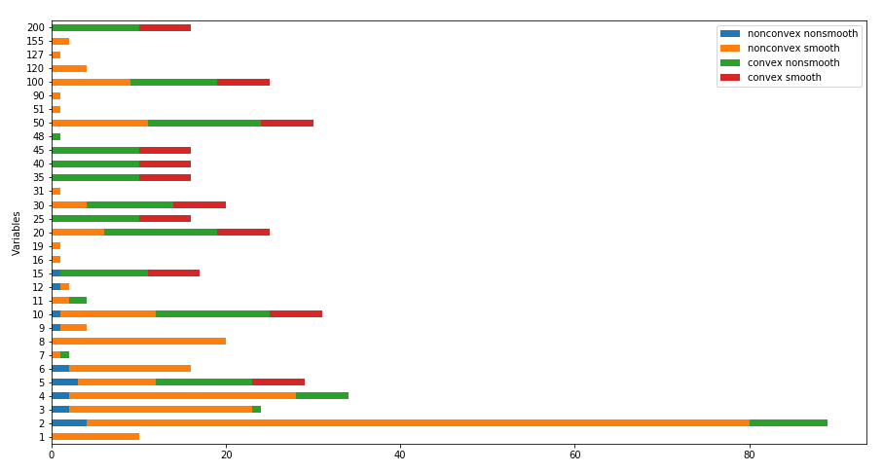
Problem set overview
Of the 500 problems, only 475 were compiled and analyzed in this report

Slide 9
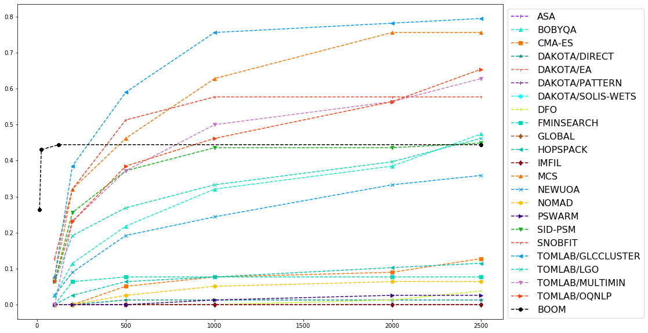
Convex Smooth Problems

Slide 10
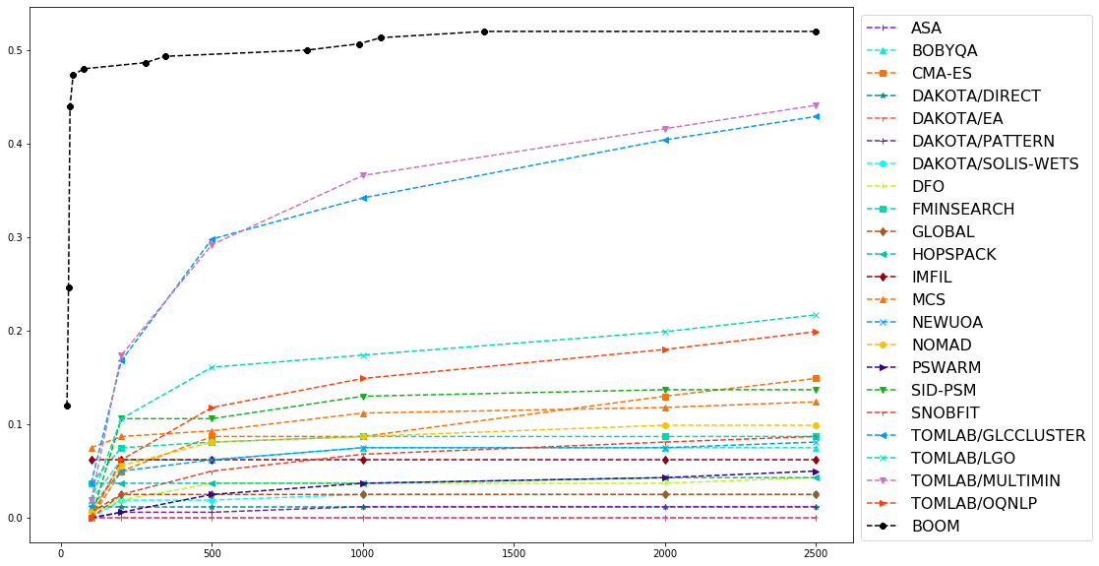
Convex Non-smooth Problems

Slide 11
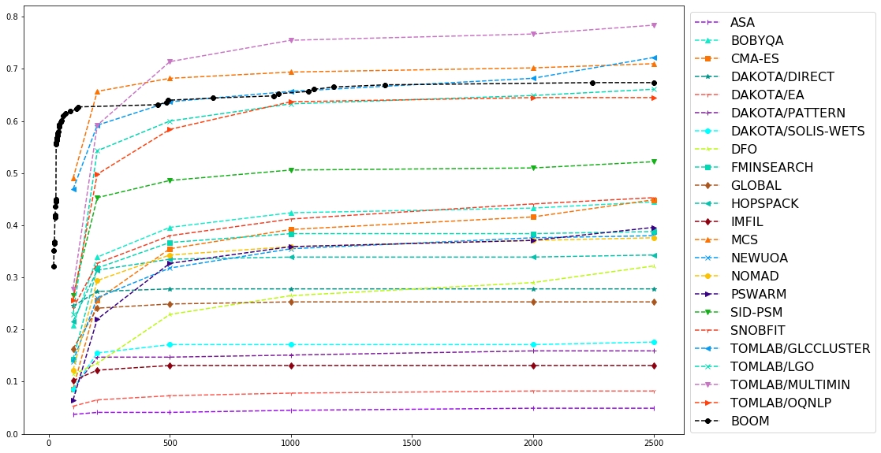
Non-Convex Smooth Problems

Slide 12
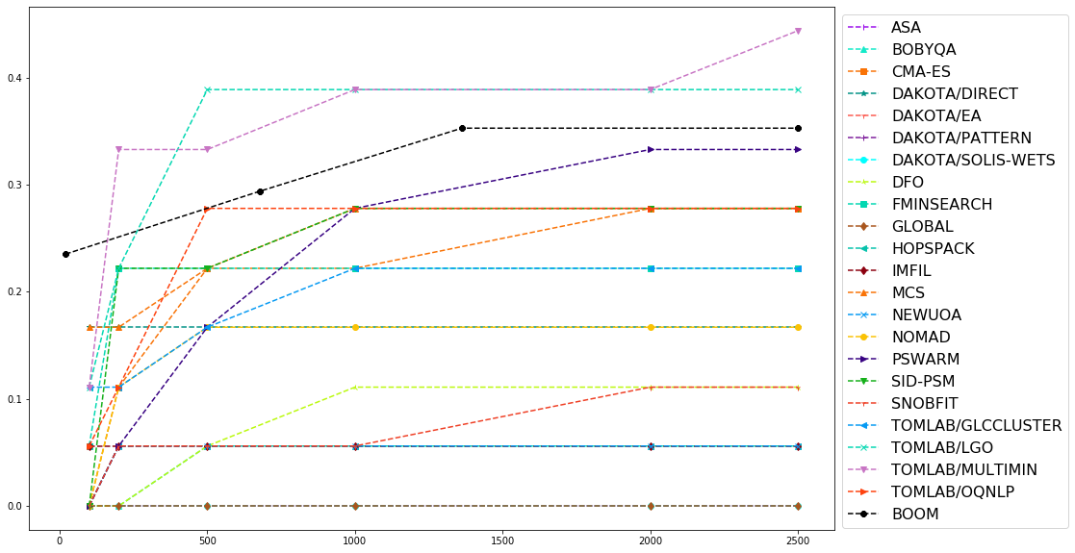
Non-Convex Non-smooth Problems

Slide 13
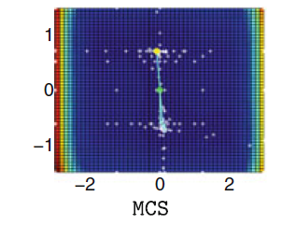
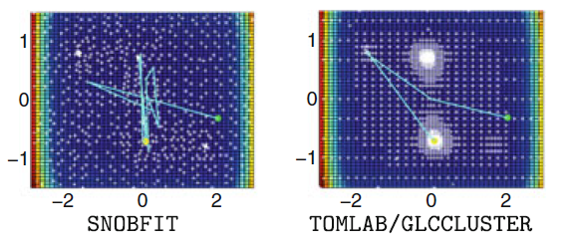
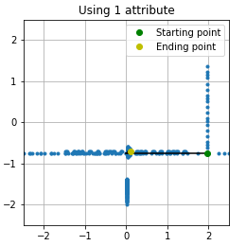
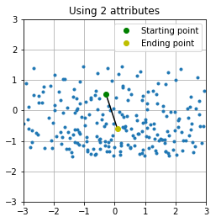
Simulation results on Camel6 problem
Implementation on most successful solvers
Implementation on the algorithm using 1 and 2 attributes

Slide 14
Hidden Constrained problem
Objective:
Minimize the total energy consumption during LNG (Liquefied Natural Gas) Production.
Variables:
4 variables: Pressures at different locations
4 variables: Composition variables
This problem on solving reached the best solution of 1170.786 kJ/kg
The model converged at this value for this problem with hidden constraints
The modified DIRECT algorithm obtains a better solution. Hence, maybe better

Slide 15
Conclusions
The algorithm converges for many problems in lower dimensions
Finding a good initial point in higher dimensions is difficult
The algorithm gets stuck on local minima; to avoid this, a way to incorporate the second moment can also be incorporated to move in the direction of global minima.

